Slide 1
Legal Silk Road
Buy and Sell goods at your convenience…..
Creators: Keith, Kinan, and Nali

Slide 2
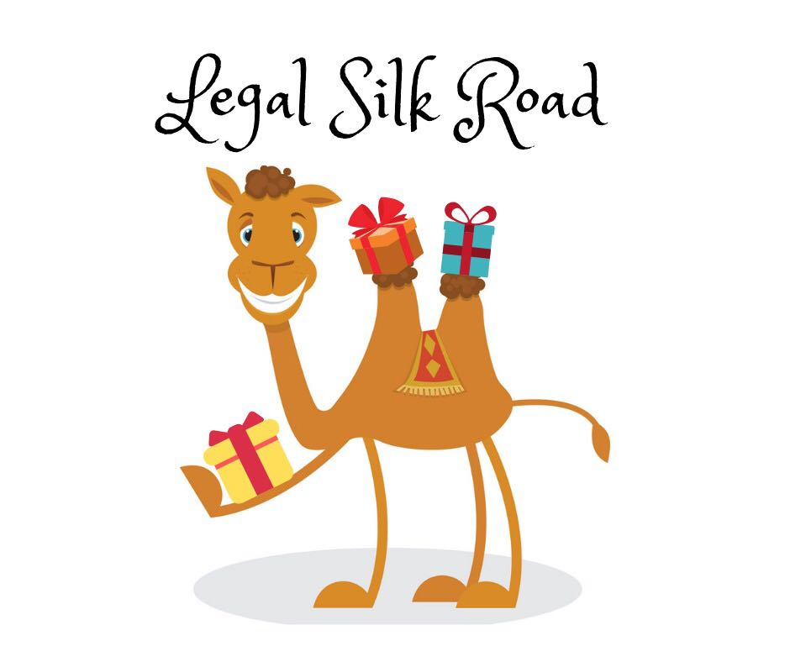
“Legal Silk Road (LSR) is a new e-commerce tool designed to improve the experiences of everyday online shoppers and sellers, LSR provides an easy-to-use tool for both first-time and skilled sellers to upload photos and descriptions about their products. LSR removes the middleman from buyers and sellers to provide a stress free online shopping experience.”

Slide 3
Motivation for creating this Application :
Allow for businesses to have access to a template e-commerce site to help improve their business sales.
Offer an available e-commerce site that allows individuals to buy or sell items to the public.
Reduce third party transaction fees and restrictions.

Slide 4
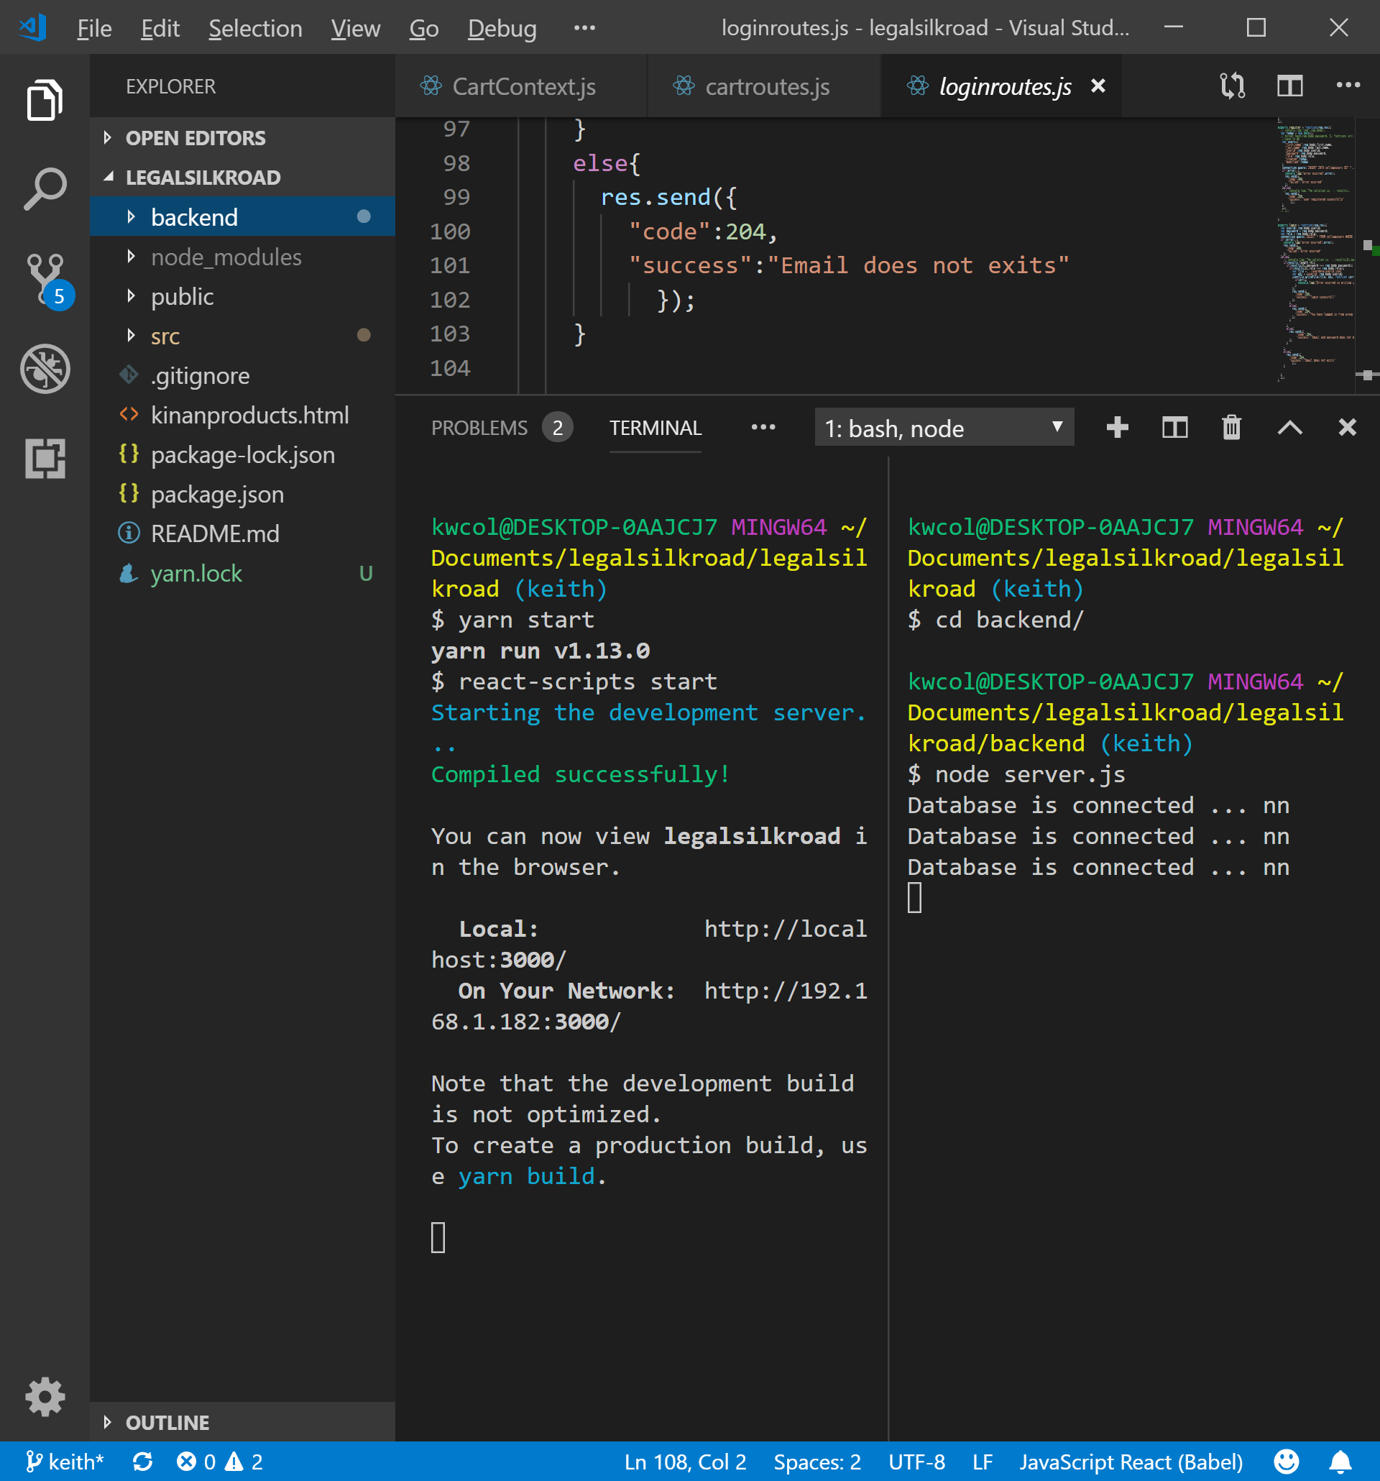
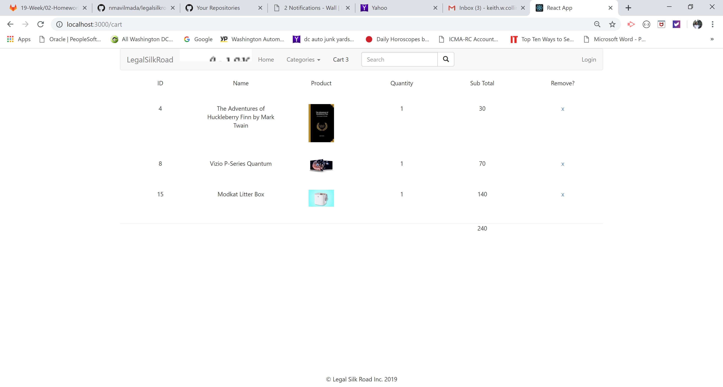
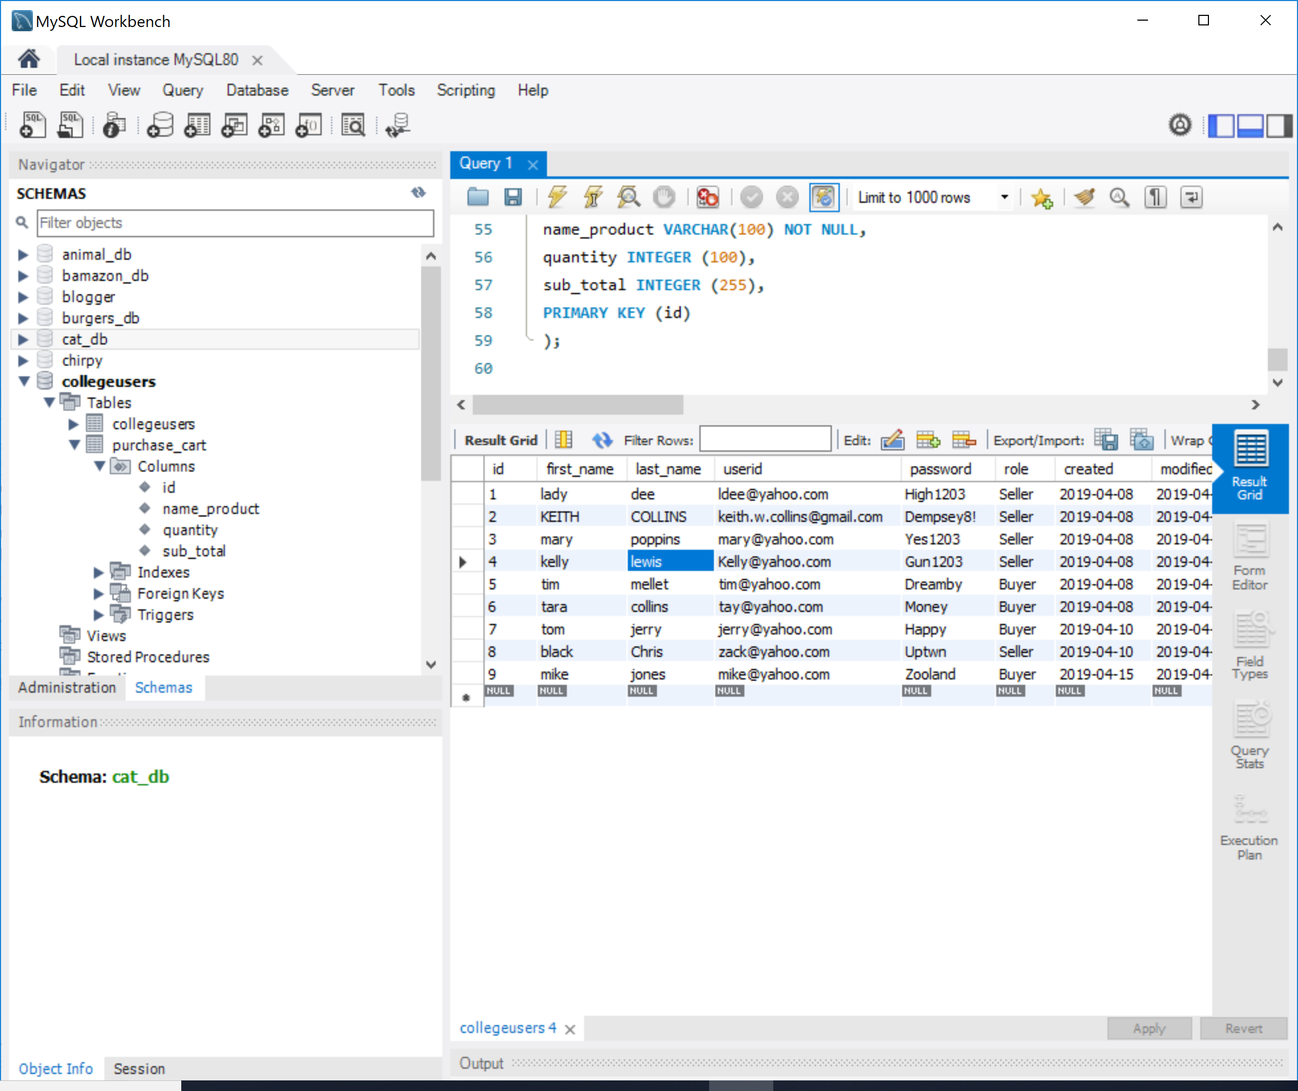
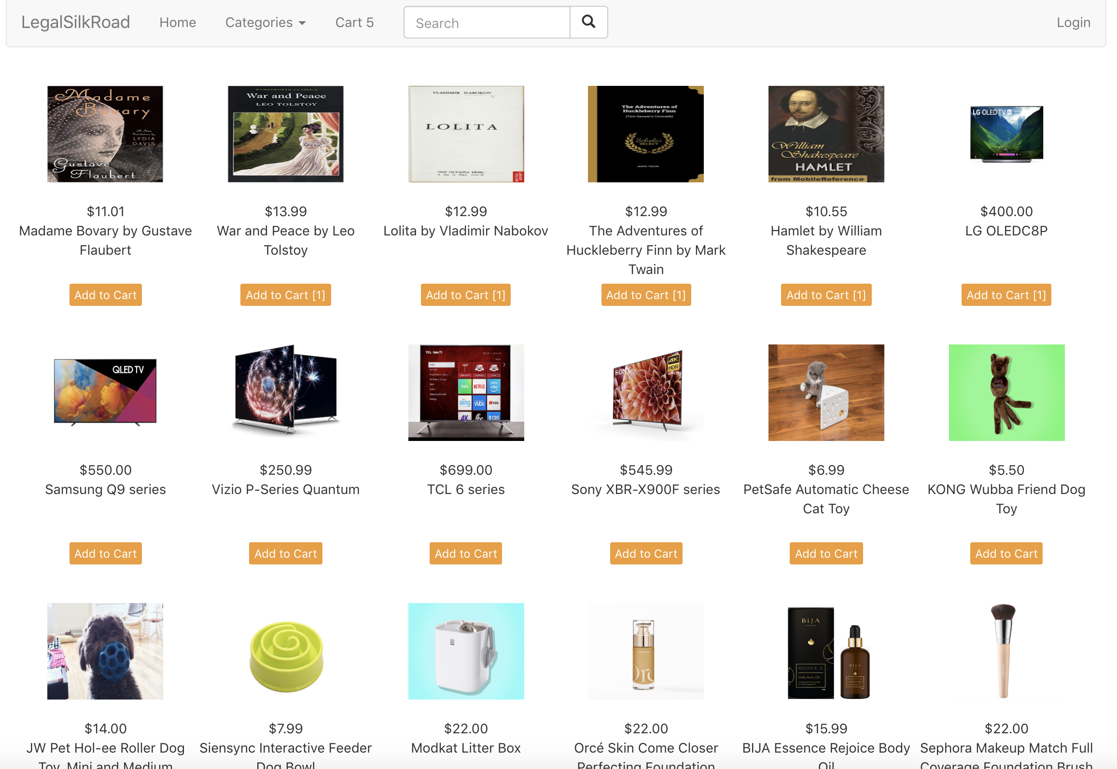
Results from this application process :

Slide 5
Challenges the team faced :
CORS challenge getting front and backend to work together on different ports.
Heroku deployment

Slide 6
Future Improvements and features :
Users will allow the application to track their cookies and browsing behaviors in order to automate a custom gift wish list for their loved ones.
We will also build in a social network, so that users can share their automatically generated gift wish list with their friends and family to make the gift giving process easier.
Location tracking for meet up and delivery of purchased items.
Upload functions for Seller to add and remove products from inventory.
Adding PayPal function for payment method.

Slide 7
Team Efforts & Individual Responsibilities:
Keith: Login function and authentication with completed backend code for server using node.js and MySQL. Power Point presentation template.
Kinan: Built the landing page, product page, contact page and logo for the application. Conducted market research on the web application storefront for JSON file needs.
Nali: Lead Repo management, managing work flow. Front end development for product pages and cart page. Managing Git HUB and resolving Git HUB issues.
New Technology used: useContext hook

